Slide 1
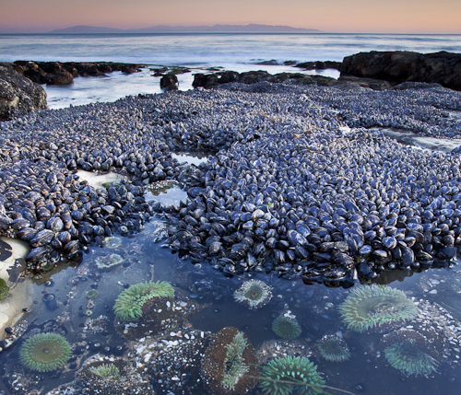
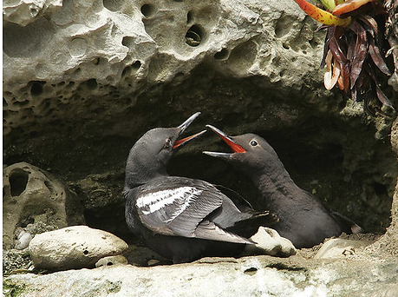
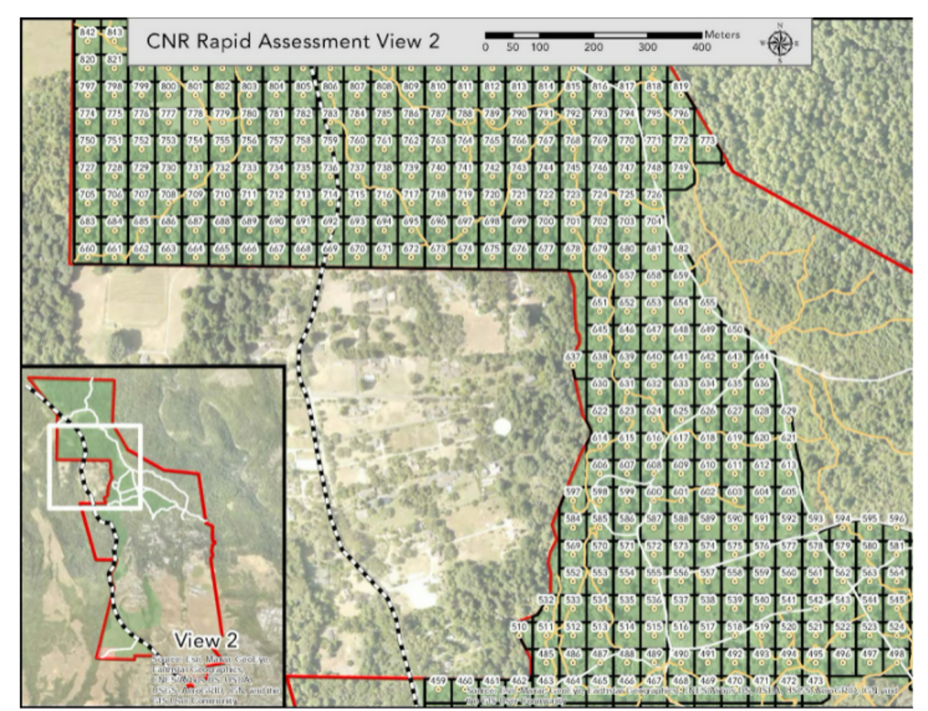
IDEASS CRSN 152-02
Natural Resource Management Instructor: Kristen Heady
INTERTIDAL HARVESTING
SEABIRDS VS PIGEON NEST SITES
CAMPUS NATURAL RESERVE
UCSC’s Long Range Development Plan (LRDP) for 2040 increased the area of campus reserve and maintained a large portion of campus as natural space. Students will continue to survey the 50 m² grid units. mapping major habitat types, native, exotic and rare plant species, trails, campsites and sink holes.
Davenport Landing is one of the only intertidal that is not within a Marine Protected Area in Santa Cruz Co. Mussels are being harvested during low tides by people with Fishing Licences. We will survey collectors to assess how many mussels are being collected and how is this affecting the intertidal.
Pigeon Guillemots, a sea bird, nest along West Cliff in small cavities. Rock Dove, pigeons, also nest in these same cavities. We will explore the options of excluding pigeons and restoring these nest sites for seabirds.

